Slide 1
Hashing Techniques

Slide 2
Origins of the Term
The term "hash" comes by way of analogy with its standard meaning in the physical world, to "chop and mix.” D. Knuth notes that Hans Peter Luhn of IBM appears to have been the first to use the concept, in a memo dated January 1953; the term hash came into use some ten years later.

Slide 3
Dictionary & Search ADTs
Operations
create
destroy
insert
find
delete
Dictionary: Stores values associated with user-specified keys
keys may be any (homogenous) comparable type
values may be any (homogenous) type
implementation: data field is a struct with two parts
Search ADT: keys = values
kim chi
spicy cabbage
kreplach
tasty stuffed dough
kiwi
Australian fruit
insert
kohlrabi
- upscale tuber
find(kreplach)
kreplach
- tasty stuffed dough
Notes:
Dictionaries associate some key with a value, just like a real dictionary (where the key is a word and the value is its definition).
In this example, I’ve stored user-IDs associated with descriptions of their coolness level.
This is probably the most valuable and widely used ADT we’ll hit.
I’ll give you an example in a minute that should firmly entrench this concept.

Slide 4
Time taken for a search depends on the size of the collection
Binary Search O(log n)
Linear Search O (n)
Hashing:
Storage & retrieval of data in an average time, does not depend on the collection size { O (1) }

Slide 5
General Idea
The ideal hash table structure is merely an array of some fixed size, containing the items.
A stored item needs to have a data member, called key, that will be used in computing the index value for the item.
Key could be an integer, a string, etc
e.g. a name or Id that is a part of a large employee structure
The size of the array is TableSize.
The items that are stored in the hash table are indexed by values from 0 to TableSize – 1.
Each key is mapped into some number in the range 0 to TableSize – 1.
The mapping is called a hash function.

Slide 6
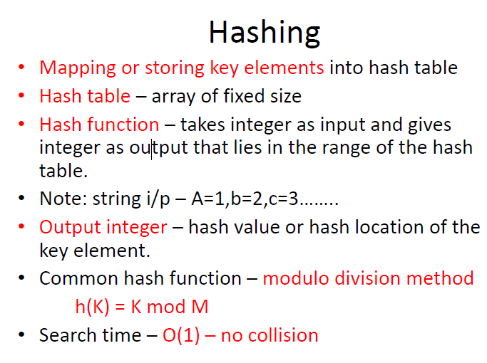

Slide 7
Concept of Hashing
In CS, a hash table, or a hash map, is a data structure that associates keys (names) with values (attributes).
Look-Up Table
Dictionary
Cache
Extended Array

Slide 8
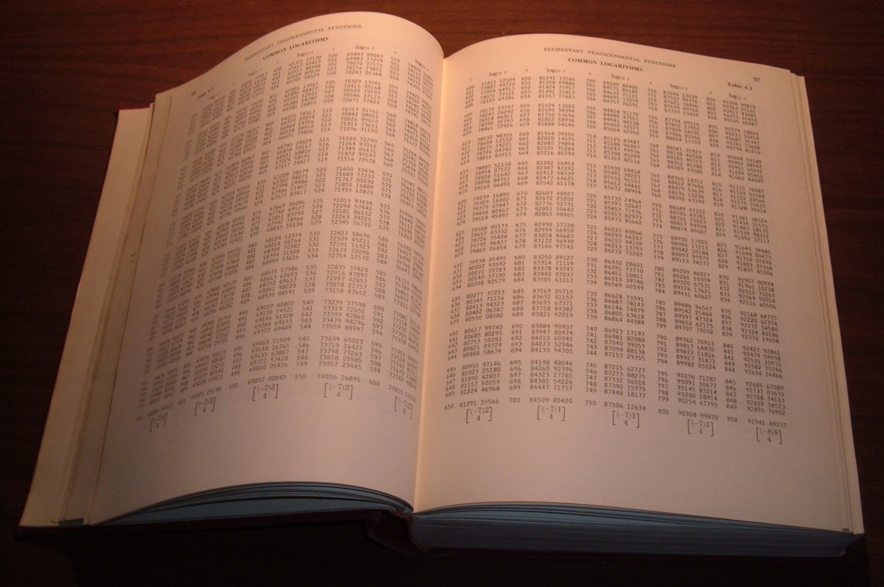
Tables of logarithms

Slide 9
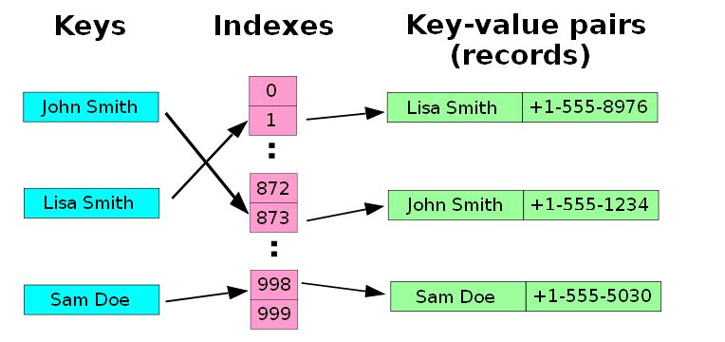
Example
A small phone book as a hash table.
(Figure is from Wikipedia)

Slide 10
Dictionaries
Collection of pairs.
(key, value)
Each pair has a unique key.
Operations.
Get(theKey)
Delete(theKey)
Insert(theKey, theValue)

Slide 11
Just An Idea
Hash table :
Collection of pairs,
Lookup function (Hash function)
Hash tables are often used to implement associative arrays,
Worst-case time for Get, Insert, and Delete is O(size).
Expected time is O(1).

Slide 12
Search vs. Hashing
Search tree methods: key comparisons
Time complexity: O(size) or O(log n)
Hashing methods: hash functions
Expected time: O(1)
Types
Static hashing
Dynamic hashing

Slide 13
Static Hashing
Key-value pairs are stored in a fixed size table called a hash table.
A hash table is partitioned into many buckets.
Each bucket has many slots.
Each slot holds one record.
A hash function f(x) transforms the identifier (key) into an address in the hash table

Slide 14
Hash table
s slots
0
1
s-1
 |  | . . .
. . . | . . . |  | . . .
 |  | . . .
0
1
b buckets
b-1

Slide 15
Hash Tables: Basic Idea
Use a key (arbitrary string or number) to index directly into an array – O(1) time to access records
A[“kreplach”] = “tasty stuffed dough”
Need a hash function to convert the key to an integer
 | Key | Data
0 | kim chi | spicy cabbage
1 | kreplach | tasty stuffed dough
2 | kiwi | Australian fruit

Slide 16
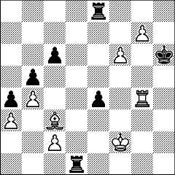
Applications
When log(n) is just too big…
Symbol tables in interpreters
Real-time databases (in core or on disk)
air traffic control
packet routing
When associative memory is needed…
Dynamic programming
cache results of previous computation
f(x) →if ( Find(x) ) then Find(x) else f(x)
Chess endgames
Many text processing applications – e.g. Web
$Status{$LastURL} = “visited”;
Notes:
Before talking about how hashing is done, let’s mention some applications.
When is it important to do lookups in constant time?

Slide 17
How could you use hash tables to…
Implement a linked list of unique elements?
Create an index for a book?
Convert a document to a Sparse Boolean Vector (where each index represents a different word)?

Slide 18
Hash Table:
Array of fixed size, whose indices are the range of hash function
Hash Function:
A function that takes an element {may be int, string} and output an integer in a certain range
This integer is used to determine the location in the table for that element
h(k) = k mod m
Hash function
Element
Table Size

Slide 19
Choice of Hash Function
Requirements
easy to compute
minimal number of collisions
If a hashing function groups key values together, this is called clustering of the keys.
A good hashing function distributes the key values uniformly throughout the range.

Slide 20
Some hash functions
Middle of square
H(x):= return middle digits of x^2
k x k = 60 x 60 = 3600 h(60) = 60, The hash value obtained is 60
Division
H(k):= return k % m
k = 1276 M = 11 h(1276) = 1276 mod 11 = 0

Slide 21
Some hash functions ….
Multiplicative:
H(x):= return the first few digits of the fractional part of x*k, where k is a fraction.
This method involves the following steps:
Choose a constant value A such that 0 < A < 1.
Multiply the key value with A.
Extract the fractional part of kA.
Multiply the result of the above step by the size of the hash table i.e. M.
The resulting hash value is obtained by taking the floor of the result obtained in step 4.

Slide 22
Some hash functions ….
h(K) = floor (M (kA mod 1))
Here, M is the size of the hash table, k is the key value, A is a constant value.
Eg. k = 12345 , A = 0.357840 , M = 100
h(12345) = floor[ 100 (12345*0.357840 mod 1)] = floor[ 100 (4417.5348 mod 1) ] = floor[ 100 (0.5348) ] = floor[ 53.48 ] = 53

Slide 23
Some hash functions…
Folding:
Partition the identifier x into several parts, and add the parts together to obtain the hash address
e.g. x=12320324111220; partition x into 123,203,241,112,20; then return the address 123+203+241+112+20=699
Shift folding vs. folding at the boundaries
Digit analysis:
If all the keys have been known in advance, then we could delete the digits of keys having the most skewed distributions, and use the rest digits as hash address.

Slide 24
Hashing By Division
Domain is all integers.
For a hash table of size b, the number of integers that get hashed into bucket i is approximately 2³²/b.
The division method results in a uniform hash function that maps approximately the same number of keys into each bucket.

Slide 25
Hashing By Division …
In practice, keys tend to be correlated.
If divisor is an even number, odd integers hash into odd home buckets and even integers into even home buckets.
20%14 = 6, 30%14 = 2, 8%14 = 8
15%14 = 1, 3%14 = 3, 23%14 = 9
divisor is an odd number, odd (even) integers may hash into any home.
20%15 = 5, 30%15 = 0, 8%15 = 8
15%15 = 0, 3%15 = 3, 23%15 = 8

Slide 26
Hashing By Division …
Similar biased distribution of home buckets is seen in practice, when the divisor is a multiple of prime numbers such as 3, 5, 7, …
The effect of each prime divisor p of b decreases as p gets larger.
Ideally, choose large prime number b.
Alternatively, choose b so that it has no prime factors smaller than 20.

Slide 27
Hash Algorithm via Division
int hash(char *key)
{
return (transform(key)
% TABLE_SIZE);
}
void init_table(element ht[])
{
int i;
for (i=0; i<TABLE_SIZE; i++)
ht[i].key[0]=NULL;
}
int transform(char *key)
{
int number=0;
while (*key) number += *key++;
return number;
}

Slide 28
Hash Function
The hash function:
must be simple to compute.
must distribute the keys evenly among the cells.
If we know which keys will occur in advance we can write perfect hash functions, but we don’t.

Slide 29
Example
0
1
Items
Hash
Function
2
3
john 25000
key
4
phil 31250
5
6
dave 27500
7
mary 28200
key
8
9

Slide 30
If function is considered – one-to –one
Many to one
h(x)= x is one to one function
This may be many to one also
Try to modify the function in such a way that
h(x) mod table size
h(x)mod 10
Given the value as 2,32,4,5,6,7,8,45,
2 mod 10 = 2
32 mod 10 = 2
where there is a collision

Slide 31
Properties of Good Hash Functions
Must return number 0, …, tablesize
Should be efficiently computable – O(1) time
Should not waste space unnecessarily
For every index, there is at least one key that hashes to it
Load factor lambda λ = (number of keys / TableSize)
Should minimize collisions
= different keys hashing to same index

Slide 32
Integer Keys
Hash(x) = x % TableSize
Good idea to make TableSize prime. Why?

Slide 33
Integer Keys
Hash(x) = x % TableSize
Good idea to make TableSize prime. Why?
Because keys are typically not randomly distributed, but usually have some pattern
mostly even
mostly multiples of 10
in general: mostly multiples of some k
If k is a factor of TableSize, then only (TableSize/k) slots will ever be used!
Since the only factor of a prime number is itself, this phenomena only hurts in the (rare) case where k=TableSize

Slide 34
Strings as Keys
If keys are strings, can get an integer by adding up ASCII values of characters in key
for (i=0;i<key.length();i++)
hashVal += key.charAt(i);
Problem 1: What if TableSize is 10,000 and all keys are 8 or less characters long?
Problem 2: What if keys often contain the same characters (“abc”, “bca”, etc.)?
Notes:
Keys will hash only to positions 0 through 8*127 = 1016

Slide 35
Hashing Strings
Basic idea: consider string to be a integer (base 128):
Hash(“abc”) = (‘a’*128² + ‘b’*128¹ + ‘c’) % TableSize
Range of hash large, anagrams get different values
Problem: although a char can hold 128 values (8 bits), only a subset of these values are commonly used (26 letters plus some special characters)
So just use a smaller “base”
Hash(“abc”) = (‘a’*32² + ‘b’*32¹ + ‘c’) % TableSize

Slide 36
Hashing:
Process of mapping a key value to a position in a table
0
1
2
3
4
5
6
7
8
9
41
34
7
18
Example: 7, 18 , 41 , 34
7 % 10 = 7
18 % 10 = 8
41 % 10 = 1
34 % 10 = 4

Slide 37
IDEAL Hashing:
Hash Table is an array of some fixed size
Search is performed based on the key
Each key is mapped into some position in the range
0 to table size - 1
Drawbacks:
Waste too much space, if universe is too large compared with actual number of elements to be stored
Collision {i.e. Two keys may hash to same slot}

Slide 38
Example: To insert elements 80 , 40 , 65 , 24 , 58 , 35 , 98
Table Size = 11
0
1
2
3
4
5
6
7
8
9
10
24
80
40
65
80 % 11 = 3
40 % 11 = 7
65 % 11 = 10
24 % 11 = 2
58 % 11 = 3
35 % 11 = 2
98 % 11 = 10
Collision

Slide 39
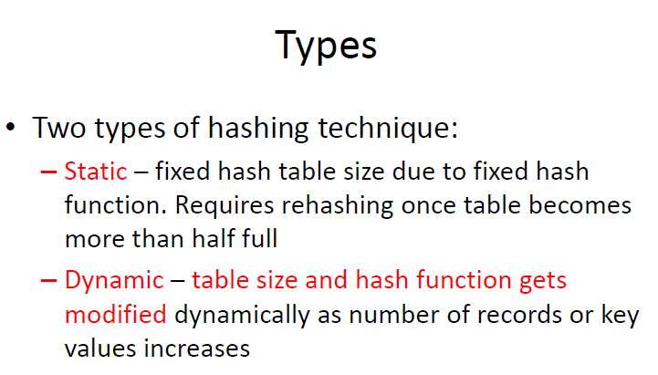

Slide 40
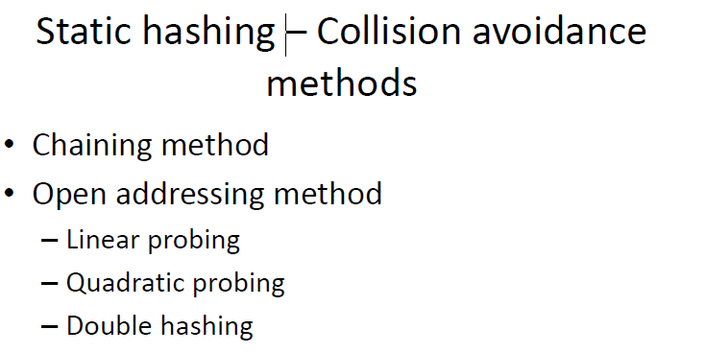

Slide 41
Difference between open and closed hashing
The difference between the two has to do with whether collisions are stored outside the table (open hashing), or whether collisions result in storing one of the records at another slot in the table (closed hashing).

Slide 42
Collision Handling Strategies
Separate Chaining
Open Addressing
Open Hashing
Closed Hashing
Linear Probing
Quadratic Probing
Double Hashing
Rehashing

Slide 43
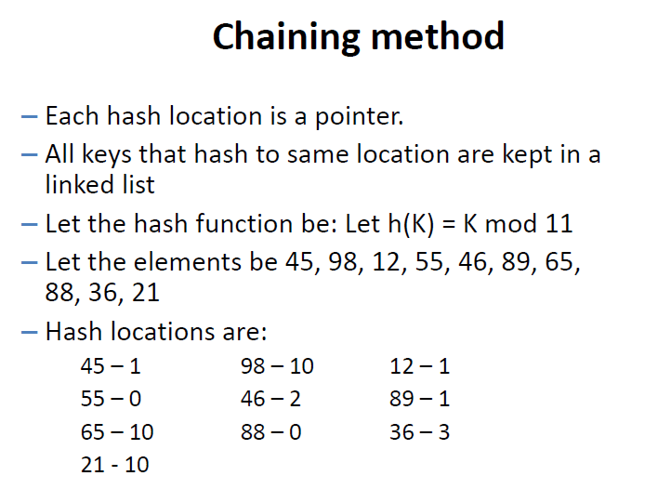

Slide 44
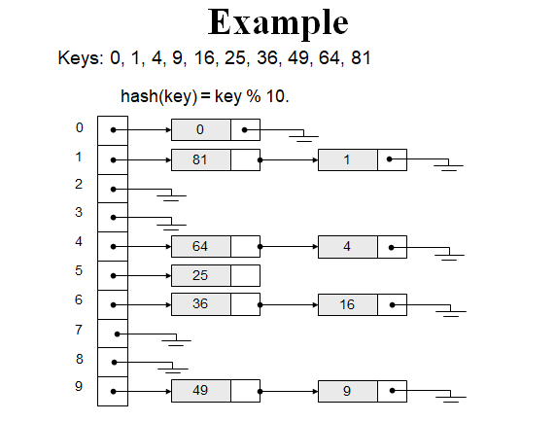
Chaining

Slide 45
Let us consider a simple hash function as “key mod 7” and sequence of keys as 50, 700, 76, 85, 92, 73, 101.

Slide 46
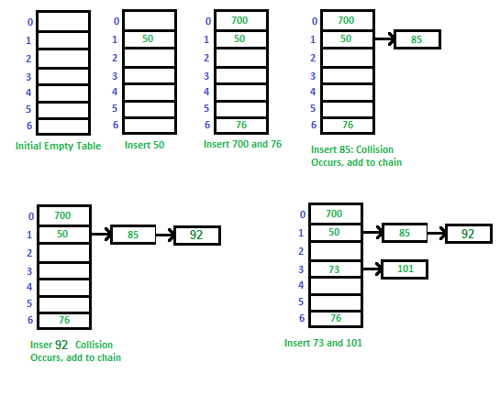
Let us consider a simple hash function as “key mod 7” and sequence of keys as 50, 700, 76, 85, 92, 73, 101.

Slide 47
Advantages of Chaining
Simple to Implement
Separate chaining is a very simple technique to implement compared to other data structures. Input elements are just added to the corresponding linked list which the input has been hashed to. No collision occurs in the table as the cells hold linked information.
Hash Table Capacity Not Limited
There is no issue with the table being filled to capacity, as the table cells only hold linked information. New elements are just added to the corresponding chain.
The hash table can be of theoretically infinite size
The hash table will not get polluted
When searching, it will never search irrelevant information.

Slide 48
Disadvantages
Chaining has the disadvantage of using linked lists.
Requires the implementation of a second data structure.

Slide 49
Load Factor with Separate Chaining
Search cost (assuming simple uniform hashing)
unsuccessful search:
Whole list – average length λ
successful search:
Half the list – average length λ/2+1
Optimal load factor:
Zero! But between ½ and 1 is fast and makes good use of memory.
Notes:
Let’s analyze it.
How long does an unsuccessful search take?
Well, we have to traverse the whole list wherever we hash to.
How long is the whole list?
On average, λ.
How about successful search?
On average we traverse only half of the list before we find the one we’re looking for (but we still have to check that one): λ/2 + 1
So, what load factor might we want?
Obviously, ZERO!
But we can shoot for between 1/2 and 1.

Slide 50
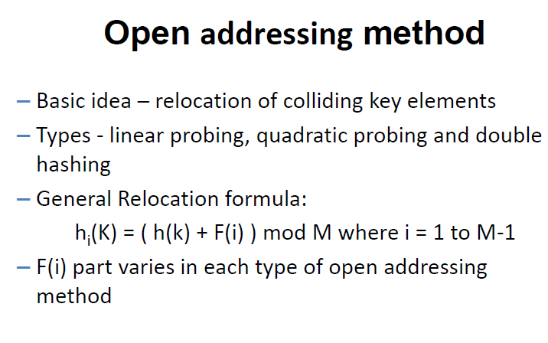

Slide 51
Open Addressing:
Relocate the key, if it collides with existing key { Store k at an entry different from T [ h (k) ] }
Insertion: To insert key k, Compute h₀ (k)
If T [ h₀ (k) ] = empty , insert key
If Collision occurs, probe alternative cells h₁ (k) , h₂ (K) … Until empty cell is found
h_{i} (k) = ( hash (k) + F (i) ) mod m
m = Table Size
i = 1 to m – 1
F (0) = 0

Slide 52
Closed Hashing I : LINEAR PROBING
Linear probing is a scheme in computer programming for resolving collisions in hash tables, data structures for maintaining a collection of key–value pairs and looking up the value associated with a given key.

Slide 53
Linear Probing:
Cells are probed sequentially with wrap around
F ( i ) = i
After searching cell hash (k) in the array look in hash (k) + 1 , hash (k) + 2 …etc
h _{i} ( k ) = (hash (k) + i ) mod m

Slide 54
Example: 89 , 18 , 49 , 58 , 69
0
1
2
3
4
5
6
7
8
9
49
58
69
18
89
h ( k ) = k mod 10
89 % 10 = 9
18 % 10 = 8
49 % 10 = 9
58 % 10 = 8
69 % 10 = 9

Slide 55
linear probing is a form of open addressing.
In these schemes, each cell of a hash table stores a single key–value pair.
When the hash function causes a collision by mapping a new key to a cell of the hash table that is already occupied by another key, linear probing searches the table for the closest following free location and inserts the new key there.
h(x) =x mod size of array
if collision occurs
h(x) =[ h(x) +f(i)] mod size
where f(i)= i, where i =0,1,2,3,…

Slide 56
In linear probing, collisions are resolved by sequentially scanning an array (with wrap around) until an empty cell is found.
i.e. f is a linear function of i, typically f(i)= i.
Example:
Insert items with keys: 89, 18, 49, 58, 9 into an empty hash table.
Table size is 10.
Hash function is hash(x) = x mod 10.
f(i) = i;

Slide 57
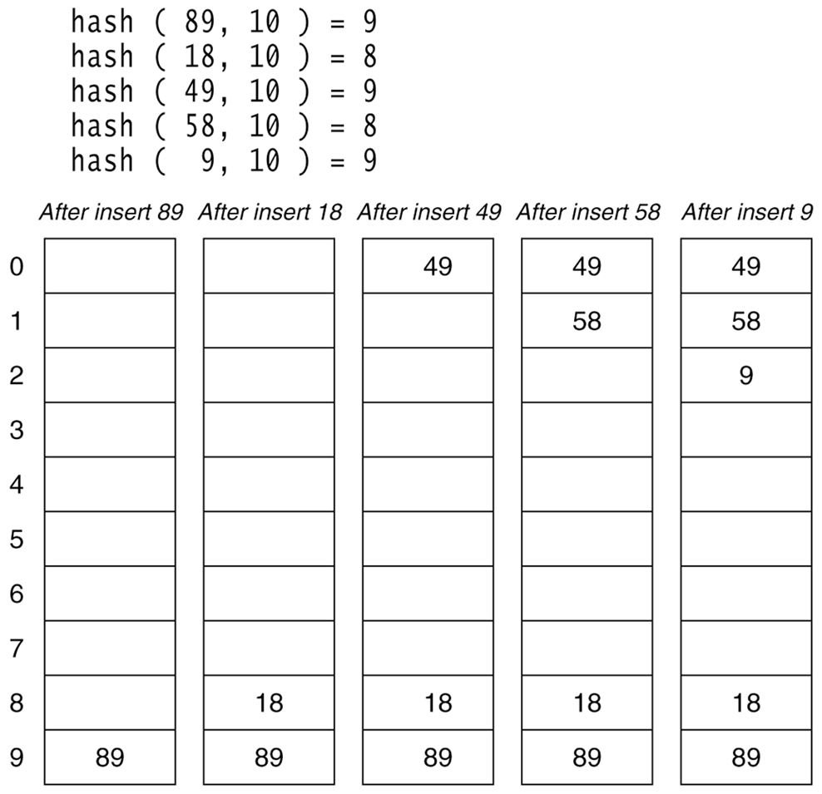

Slide 58
Lookups are performed in the same way, by searching the table sequentially starting at the position given by the hash function ( h(x) mod size ), until finding a cell with a matching key or an empty cell.

Slide 59
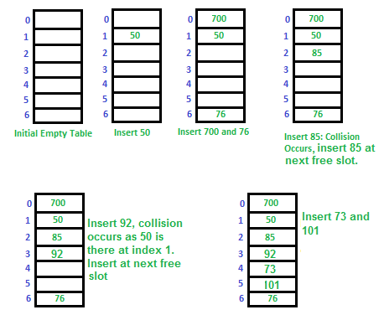
Let us consider a simple hash function as “key mod 7” and a sequence of keys as 50, 700, 76, 85, 92, 73, 101.

Slide 60
Drawbacks:
Clustering of element in particular location .The time taken to check will be more.
Encounter Primary Clustering { blocks of contiguously occupied table entries}
Many consecutive elements form groups and it starts taking time to find a free slot or to search for an element.
If h ( k ) falls in Cluster , Cluster will definitely grow in size by one
If two Cluster separated by one entry, inserting one key into cluster can merge two cluster, So cluster size increase drastically by single insertion
Large Cluster are easy targets for Collision

Slide 61
Drawbacks….
As long as table is big enough, a free cell can always be found, but the time to do so can get quite large.
Any key that hashes into the cluster will require several attempts to resolve the collision, and then it will add to the cluster
So to avoid this we go for quadrating probing

Slide 62
Load Factor in Linear Probing
For any λ < 1, linear probing will find an empty slot
Search cost (assuming simple uniform hashing)
successful search:
unsuccessful search:
Performance quickly degrades for λ > 1/2
Notes:
There’s some really nasty math that shows that (because of things like primary clustering), each successful search w/linear probing costs…
That’s 2.5 probes per unsuccessful search for lambda = 0.5.
50.5 comparisons for lambda = 0.9
We don’t want to let lambda get above 1/2 for linear probing.

Slide 63
Closed Hashing II : Quadratic Probing
h(x) =[ h(x) +f(i)] mod size
where f[i)= i^2, where i =0,1,2,3,…
Main Idea: Spread out the search for an empty slot – Increment by i² instead of i
h_{i}(X) = (Hash(X) + i²) % Table Size , i=0,1,2,3…..,
h₀(X) = Hash(X) % Table Size
h₁(X) = [Hash(X) + 1] % Table Size
h₂(X) = [Hash(X) + 4] % Table Size
h₃(X) = [Hash(X) + 9] % Table Size

Slide 64
Quadratic Probing Example: insert 14,8,21,2,7 with size m=7
insert(14)
14%7 = 0
insert(8)
8%7 = 1
insert(21)
21%7 =0
insert(2)
2%7 = 2
0
14
0
14
0
14
0
14
1
1
8
1
8
1
8
2
2
2
2
2
3
3
3
3
4
4
4
21
4
21
5
5
5
5
6
6
6
6
1
1
3
1
probes:
Notes:
You can see that this works pretty well for an empty table and gets worse as the table fills up.
There’s another problem here. If a bunch of elements hash to the same spot, they mess each other up.
But, worse, if a bunch of elements hash to the same area of the table, they mess each other up! (Even though the hash function isn’t producing lots of collisions!)
This phenomenon is called primary clustering.

Slide 65
Problem With Quadratic Probing
insert(14)
14%7 = 0
insert(8)
8%7 = 1
insert(21)
21%7 =0
insert(2)
2%7 = 2
insert(7)
7%7 = 0
0
14
0
14
0
14
0
14
0
14
1
1
8
1
8
1
8
1
8
2
2
2
2
2
2
2
3
3
3
3
3
4
4
4
21
4
21
4
21
5
5
5
5
5
6
6
6
6
6
probes:
1
1
3
1
??
Notes:
You can see that this works pretty well for an empty table and gets worse as the table fills up.
There’s another problem here. If a bunch of elements hash to the same spot, they mess each other up.
But, worse, if a bunch of elements hash to the same area of the table, they mess each other up! (Even though the hash function isn’t producing lots of collisions!)
This phenomenon is called primary clustering.

Slide 66
Limitations:
In the Above example the process is never ending and the no : of probes increases but to identify a cell and to store the element is not possible
In the case of quadratic probing, the situation is even more drastic.
There is no guarantee of finding an empty cell once the table gets more than half full, or even before the table gets half full if the table size is not prime.
So an empty key space can always be found as long as at most (n / 2),(with size of the table is n) locations are filled, i.e., the hash table is not more than half full.

Slide 67
Get the key hash key k
Set counter j = 0
3. Compute hash function h[k] = k % SIZE
4. If hash table[h[k]] is empty
(4.1) Insert key k at hash table[h[k]]
(4.2) Stop
Else
(4.3) The key space at hash table[h[k]] is occupied, so we need to find the next available key space
(4.4) Increment j
(4.5) Compute new hash function h[k] = ( k + j * j ) % SIZE
(4.6) Repeat Step 4 till j is equal to the SIZE of hash table
5. The hash table is full
6. Stop

Slide 68
Load Factor in Quadratic Probing
Theorem: If TableSize is prime and λ ≤ ½, quadratic probing will find an empty slot; for greater λ, might not
With load factors near ½ the expected number of probes is empirically near optimal – no exact analysis known
Don’t get clustering from similar keys (primary clustering), still get clustering from identical keys (secondary clustering)
Notes:
That’s actually pretty close to perfect… but there are two problems.
First, we might fail if the load factor is above 1/2.
Second, quadratic probing still suffers from secondary clustering. That’s where multiple keys hashed to the same spot all follow the same probe sequence.
How can we solve that?

Slide 69
Closed Hashing III : Double Hashing
Double hashing is a collision resolving technique in Open Addressed Hash tables. Double hashing uses the idea of applying a second hash function to key when a collision occurs.
Double hashing can be done using :
(hash1(key) + i * hash2(key)) % TABLE_SIZE
Here hash1() and hash2() are hash functions and TABLE_SIZE is size of hash table.
(We repeat by increasing i when collision occurs)
First Hash function is : hash1(key) = key % TABLE_SIZE
Second Hash function is : hash2(key) = PRIME – (key % PRIME)
where PRIME is a prime smaller than the TABLE_SIZE.
A good second Hash function is:
- It must never evaluate to zero
- Must make sure that all cells can be probed

Slide 70
Closed Hashing III: Double Hashing
Idea: Spread out the search for an empty slot by using a second hash function
No primary or secondary clustering
h_{i}(X) = (Hash₁(X) + i*Hash₂(X)) mod Table Size
for i = 0, 1, 2, …
Good choice of Hash₂(X) can guarantee does not get “stuck” as long as λ < 1
Integer keys: Hash₂(X) = R – (X mod R) where R is a prime smaller than Table Size

Slide 71
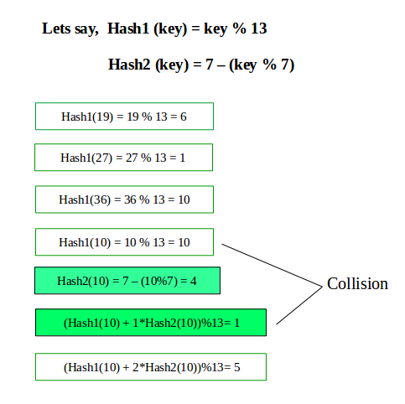

Slide 72
Double Hashing Example
insert(14)
14%7 = 0
insert(8)
8%7 = 1
insert(21)
21%7 =0
5-(21%5)=4
insert(2)
2%7 = 2
insert(7)
7%7 = 0
5-(7%5)=3
(0+1*4)%7=4
0
14
0
14
0
14
0
14
0
14
1
1
8
1
8
1
8
1
8
2
2
2
2
2
2
2
3
3
3
3
3
4
4
4
21
4
21
4
21
5
5
5
5
5
6
6
6
6
6
probes:
1
1
2
1
??
Notes:
You can see that this works pretty well for an empty table and gets worse as the table fills up.
There’s another problem here. If a bunch of elements hash to the same spot, they mess each other up.
But, worse, if a bunch of elements hash to the same area of the table, they mess each other up! (Even though the hash function isn’t producing lots of collisions!)
This phenomenon is called primary clustering.

Slide 73
Double Hashing Example
insert(14)
14%7 = 0
insert(8)
8%7 = 1
insert(21)
21%7 =0
5-1(21%5)=4
insert(2)
2%7 = 2
insert(7)
7%7 = 0 +
5-(7%5)=3
0
14
0
14
0
14
0
14
0
14
1
1
8
1
8
1
8
1
8
2
2
2
2
2
2
2
3
3
3
3
3
7
4
4
4
21
4
21
4
21
5
5
5
5
5
6
6
6
6
6
probes:
1
1
2
1
4
Notes:
You can see that this works pretty well for an empty table and gets worse as the table fills up.
There’s another problem here. If a bunch of elements hash to the same spot, they mess each other up.
But, worse, if a bunch of elements hash to the same area of the table, they mess each other up! (Even though the hash function isn’t producing lots of collisions!)
This phenomenon is called primary clustering.

Slide 74
Advantages:
skip values give different search paths for keys that collide.
Disadvantage:
delete cumbersome to implement

Slide 75
Home work : Hashing problem
Given the following input (3471, 1323, 6173, 4199, 4344, 9679,1989) and a hash function h(x)= x mod 10 show the resulting
A) Separate chaining hash table
B) Hash table using Linear Probing
C) Hash table using Quadratic Probing
D) Hash table with second Hash function
h₂(x) = 7- ( x mod 7 )

Slide 76
Load Factor in Double Hashing
For any λ < 1, double hashing will find an empty slot (given appropriate table size and hash₂)
Search cost approaches optimal (random re-hash):
successful search:
unsuccessful search:
No primary clustering and no secondary clustering
Still becomes costly as λ nears 1.
Note natural logarithm!
Notes:
We can actually calculate things more precisely than this, but let’s not.
Basically, this gets us optimal performance (actually, we _can_ do better).
Quadratic may be a better choice just to avoid the extra hash, however.

Slide 77
Comparison
Linear probing has the best cache performance but suffers from clustering. One more advantage of Linear probing is easy to compute.
Quadratic probing lies between the two in terms of cache performance and clustering.
Double hashing has poor cache performance but no clustering. Double hashing requires more computation time as two hash functions need to be computed.

Slide 78
S.No. | Separate Chaining | Open Addressing
1. | Chaining is Simpler to implement. | Open Addressing requires more computation.
2. | In chaining, Hash table never fills up, we can always add more elements to chain. | In open addressing, table may become full.
3. | Chaining is Less sensitive to the hash function or load factors. | Open addressing requires extra care for to avoid clustering and load factor.
4. | Chaining is mostly used when it is unknown how many and how frequently keys may be inserted or deleted. | Open addressing is used when the frequency and number of keys is known.
5. | Cache performance of chaining is not good as keys are stored using linked list. | Open addressing provides better cache performance as everything is stored in the same table.
6. | Wastage of Space (Some Parts of hash table in chaining are never used). | In Open addressing, a slot can be used even if an input doesn’t map to it.
7. | Chaining uses extra space for links. | No links in Open addressing

Slide 79
Rehashing

Slide 80
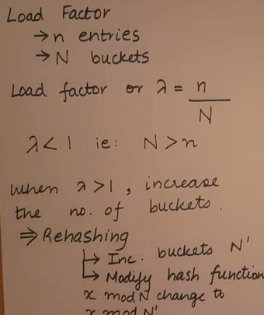
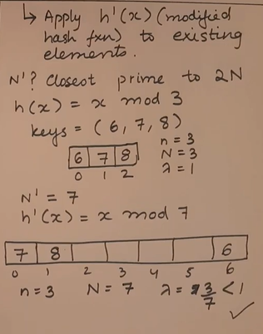
Rehashing

Slide 81
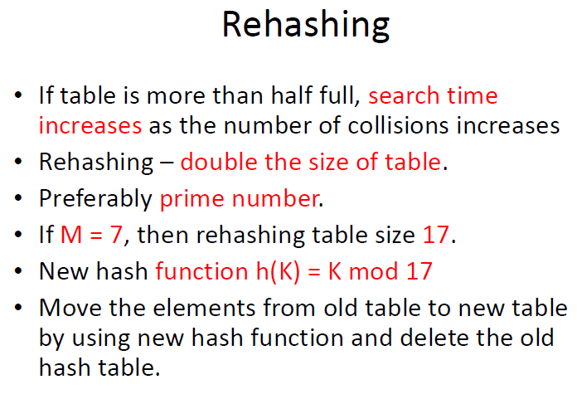

Slide 82
When shall we go for rehashing ?
As and when the hash table is half full
During Insertion failure
Reaches particular load factor

Slide 83
Rehashing:
Steps to be followed:
Build a new table that is about twice as big as old one
Compute new hash function
Compute new hash value for each non-deleted element
Insert it in the new table

Slide 84
Example: 13 , 15 , 24 , 6 , 23
Table Size = 7
Hash Function h(x) = x mod 7
{Linear probing is used}
0
1
2
3
4
5
6
6
15
24
13
13 % 7 = 6
6 % 7 = 6
15 % 7 = 1
24 % 7 = 3
23 % 7 = 2

Slide 85
Insert element 23:
0
1
2
3
4
5
6
6
15
23
24
13
Table size is 70% Full {Create new table of size 17}

Slide 86
0
1
.
.
6
7
8
.
13
14
15
16
6
23
24
13
15
New hash Table:
h (x) = x mod 17
6 % 17 = 6
15 % 17 = 15
23 % 17 = 6
24 % 17 = 7
13 % 17 = 13

Slide 87
Excercise
Insert the following numbers 2111, 1371, 2123, 1443, 5699, 7086, 1919 using the hash function h(X)=X mod 11. Find out the result of open addressing hash table using any of the probing. Identify the need for rehashing and display the final result of rehashing

Slide 88
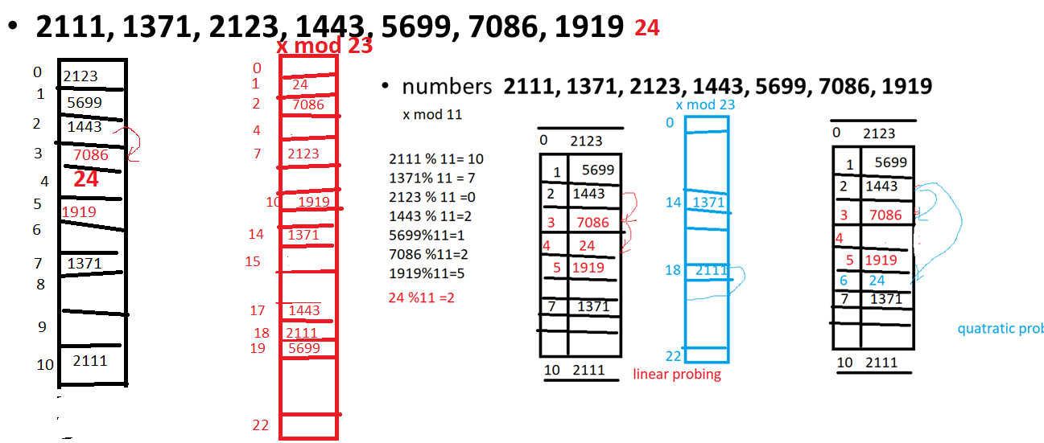

Slide 89
RANDOM PROBING
Hash fun H(x)= ( key mod 11) +1
When collision occurs
H(x)= (i+p)% m +1 where i is the index value and p is the prime no, m is the size of the hash table

Slide 90
Eg. Insert 23 i=(23%11)+1=2 Insert 45 i=(45%11)+1=2 collision occurs
0
1
2 | 23
3
4
5
6
7
8
9
10

Slide 91
When collision i=(i+P)%11+1 =(2+5)%11+1=8 =(8+5)%11+1=3 =(3+5)%11+1=9 =(9+5)%11+1=4 (4+5)%11+1=10 (10+5)%11+1=5 (5+5)%11+1=11 (11+5)%11+1=6
0
1
2 | 23
3 | 56
4 | 78
5
6
7
8 | 45
9 | 67
10 | 89

Slide 92
Draw backs
Random sequence Generated for a particular hash value forms sub cluster because of the selection of the prime number.
This can be handled by either rehashing or double hashing

